Slide 1

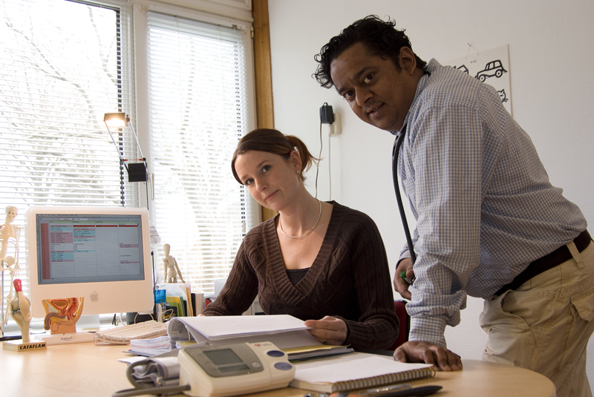



Master Advanced Nursing Practice
Hanzehogeschool Groningen
University of Applied Sciences
Notes:
I have been asked to tell you something about the masters program we have in nursing practice
I prepeired a presentation. It’s in orange: our national colour.
Introduce my self:
Teacher in the bachelor program and I also teach in the program that trains nurses to work in the general practice.
My carreer: I studied in this school to get my bachelor degree on nursing. After I finished I started working in asylum seeker centres; helping refugees. I did so for two years. After that, the ministers decided to close a lot of these centres and I lost my job. I started working as a home care nurse and through this organisation I was able to start on my master’s degree. I started working in a general practice with a general practitioner as my preceptor.

Slide 2
Content
Healthcare in the Netherlands
History MANP
Education in the Netherlands
Curriculum MANP
Practical example
Law

Slide 3

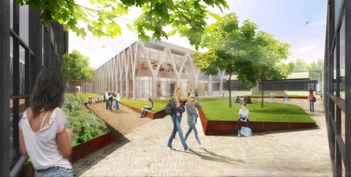
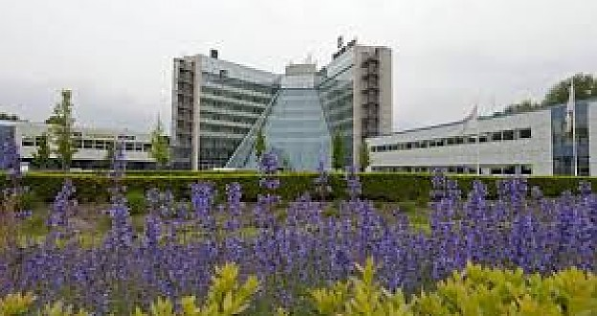
Notes:
The history of the Hanze University of Applied Sciences goes all the way back to 1798
Our current building
Future impression of our building in the center of the city of Groningen
Our slogan is: share etc

Slide 4

Healthcare in the Netherlands
Everyone has access to primary care without referral: general practitioner, dentist, pharmacist & the municipal health department (GGD)
For secondary care (the hospital) you need a referral from the general practitioner
Everyone is obliged to have healthcare assurance
Notes:
This means that patients with their medical complaints stay in primary health care longer in comparison to other EU countries. This is typical Dutch. The general practitioner is like a gatekeeper on referral to secondary care. This is to keep the costs low and to avoid unnecessary referrals. This means that the workload for the primary care doctor is quite big. The average norm of patient population for one full time primary care doctor is 2350 patients.

Slide 5
The nurse practitioner
From the eighties, it is possible to study nursing science at university level.
Since 1997 MANP: “a nurse who is deployed at the expert level for a defined group of patients with which it enters into an individual self-treatment relationship to care and cure integrated offered from the perspective of the patient to promote the continuity and the quality of both the nursing care as well as medical treatment”.
Notes:
In the past you carreer opportunities as a nurse were more situated in the area of management
In 1997 we started with the Masters program here in Groningen, later on more universities followed
At first it was a private training, meaning that the students had to pay for the program themselves, bur since 2002 we have government support.

Slide 6
History
MANP started in 1997 in Groningen
Local initiative
Hospital focus
Government support since of 2002

Slide 7
Background
Why?
Waiting-list/line of patients
Doctors: expensive, old age, shortage
Underuse experienced nurses
Necessity of care innovation
Career perspectives for nurses
Shifting tasks from medical doctors to nurse practitioners; integrating care and cure
Notes:
Why was it necessary to start thisMaster program?
Wachtlijsten
Artsen te duur, te knap en te oud
Onderbenutting ervaren verpleging
Carrière perspectief
Veranderingen in de opleiding tot medisch specialist
Feminisering
Integratie cure/care – een gezicht
Continuïteit wisselende bezetting AIO’s

Slide 8

no. of years
Primary school 8
Secundary school 4, 5, 6
Professional bachelor 4
Professional master 2
PhD programme 4
Education
in the Netherlands

Slide 9
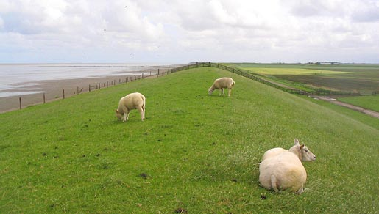
Nursing education
Three years middle level professional education: level 4
Four years higher level professional education bachelor program: level 6
Two years master advanced nursing practice: registration as clinical nurse specialist: level 7

Slide 10
Conditions
In order to start the master’s degree, you need to have at least two years of work experience in your specific field
Next to that, you need a preceptor who can supervise during the practical training
The student needs a job training contract for at least 32 hours a week

Slide 11
Three integrated parts of the program
Practical training in a specific patient population
Five specialisms
General programme
advanced nursing practice
Notes:
Students need to have an bachelor degree and at least two years of practical experience as a nurse. Current active Registered Nurse License.
The general programme takes place at our university of applied sciences. The practical training takes place at the work place of the student.
Five clinical specialisms: Acute care, intensive care, care for the chronically ill, preventive care & psychiatric care

Slide 12
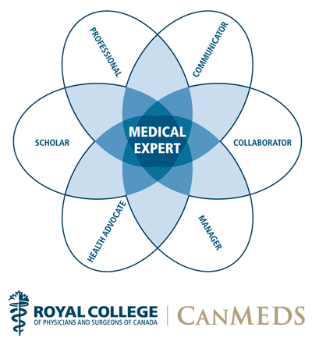
General curriculum
The general curriculum offers education to become competent in the 7 CanMEDS-roles
Notes:
Combine care & cure

Slide 13
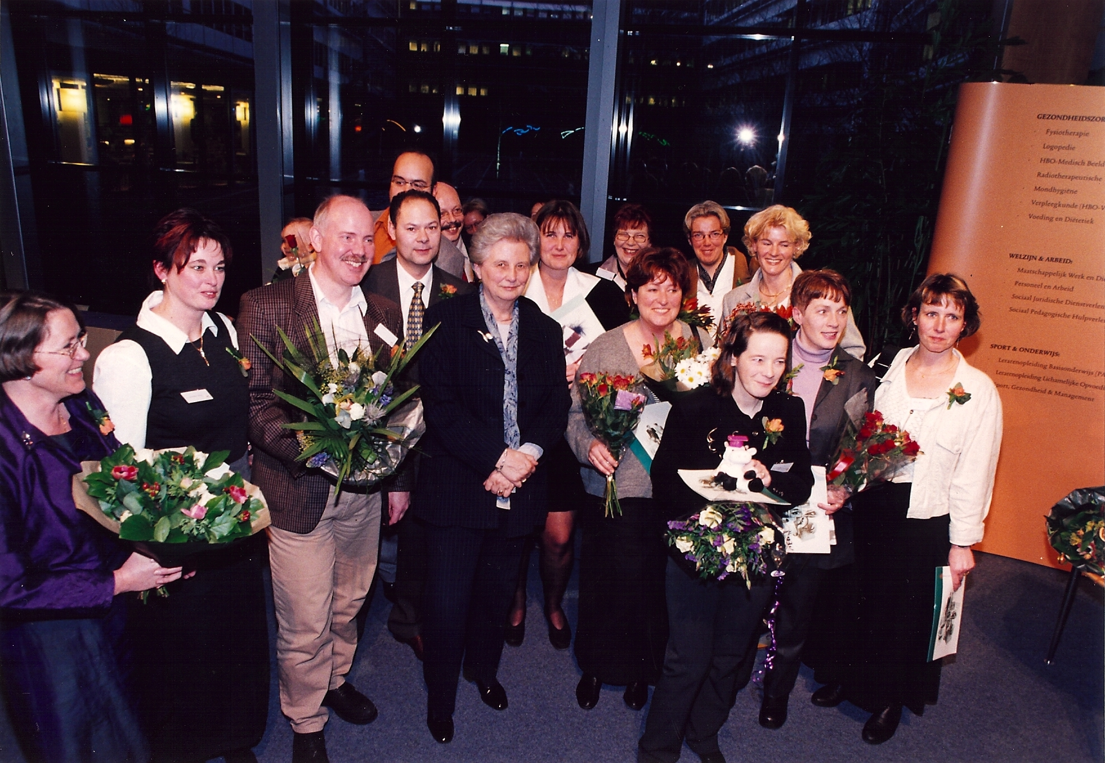
MANP in the Netherlands
The first students graduated in 2000
Notes:
It all started in 1997. When we were the first Dutch university to offer a manp program

Slide 14
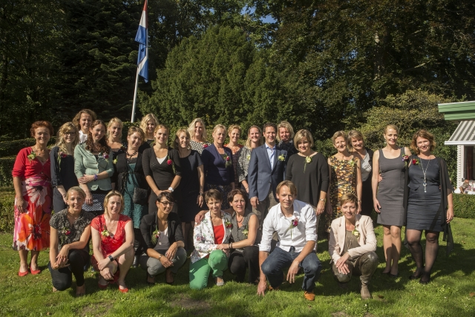
MANP is a nurse qualified at master's level professional nursing education
MANP has an autonomous role integrating cure and care
MANP integrates research, consultation, clinical leadership & innovation
MANP may be positioned in all areas of the health system
MANP
Notes:
Last years 28 graduates

Slide 15
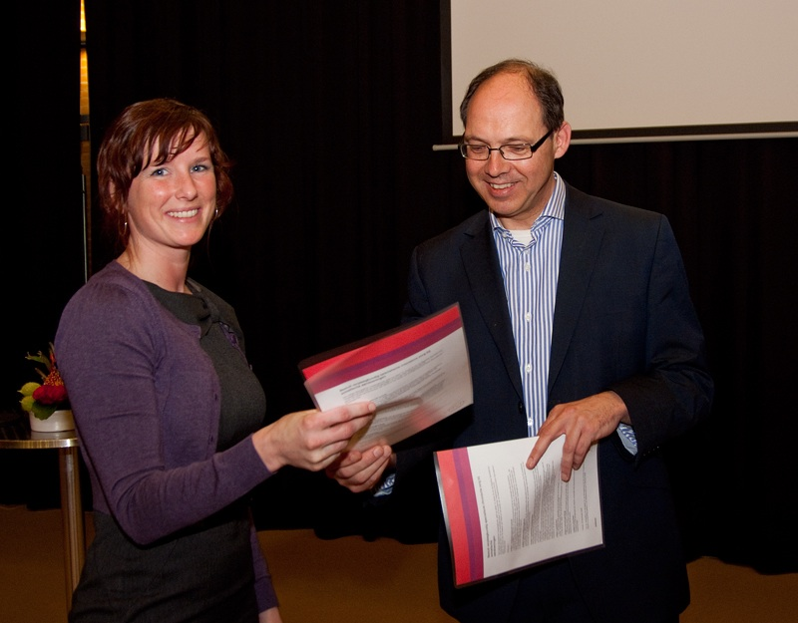
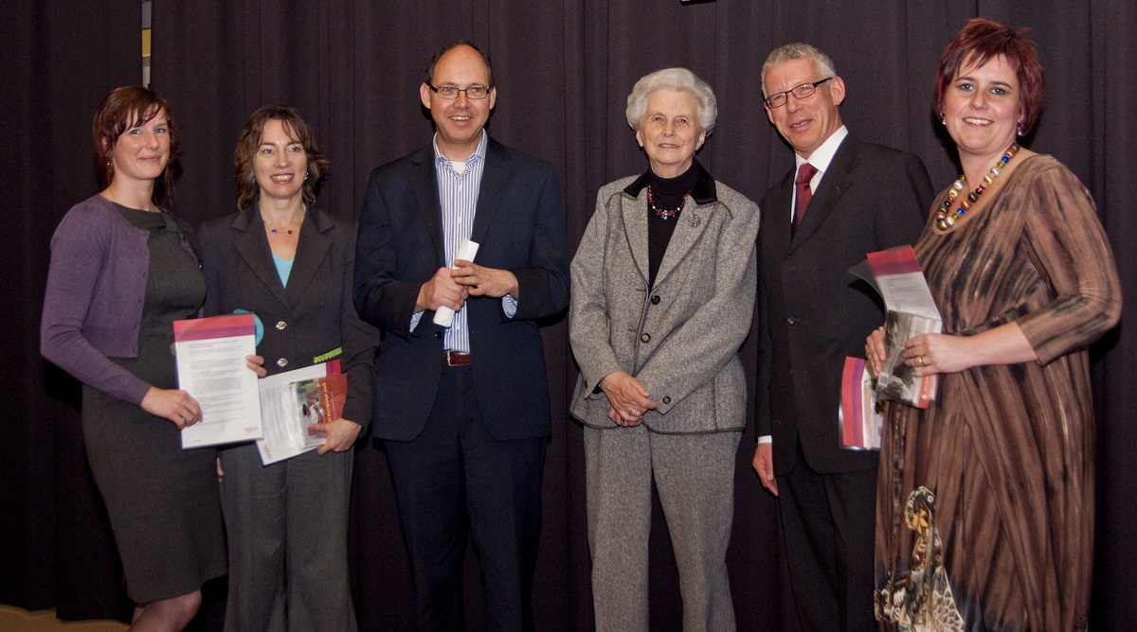
Accreditation 2009
The nurse practitioner registered in the specialist register (Article 14) of the Act on professions in individual health care (Act BIG)
Notes:
Later on: mental healthcare
Out health care minister Ab Klink and also Els Borst, who was also there when our firts NP’s graduated in 2000.
I was very privileged to meet them

Slide 16
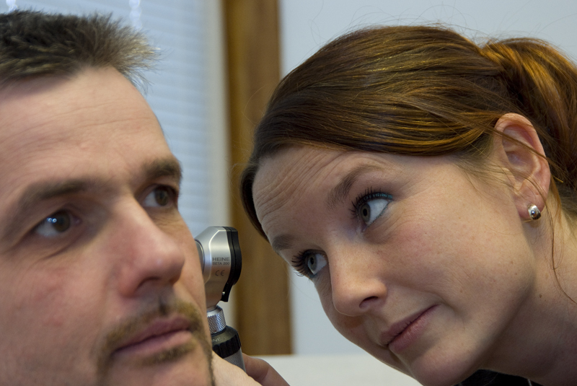
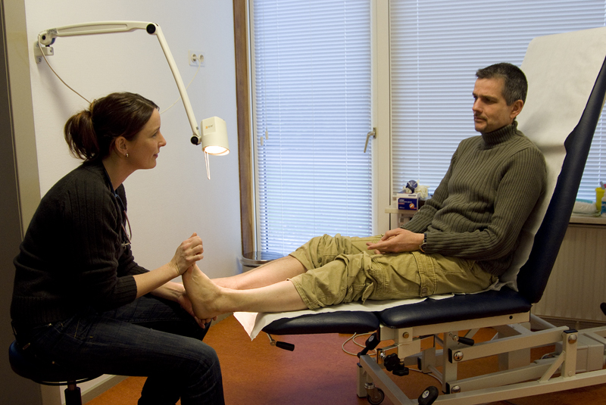
Practical example
The nurse practitioner in the general practice

Slide 17
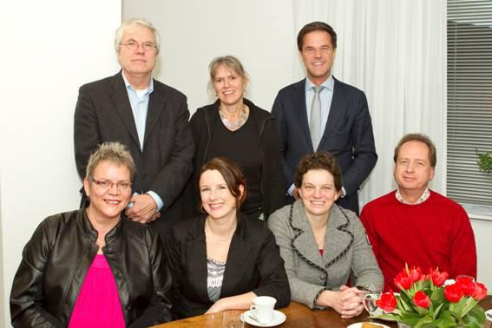
Visit of the prime minister (2011)
Notes:
In 2011 Mark Rutte, our prime minister came to Groningen to form an image of this subject. He wanted to gain information on task substitution and cost reduction concerning the NP. As you can see he visited the general practice and he also visited a nursing home. He found this wonderful examples of the potential of the function in terms of cure and care

Slide 18
December 2014: ± 2500 registered advanced nurse practitioners
Notes:
http://www.verpleegkundigspecialismen.nl/Verpleegkundigspecialist/Aantallenverpleegkundigspecialisten.aspx (12/15/2014)
Now about 2500

Slide 19
Age of Dutch MANP’s
Notes:
Mean age 45

Slide 20
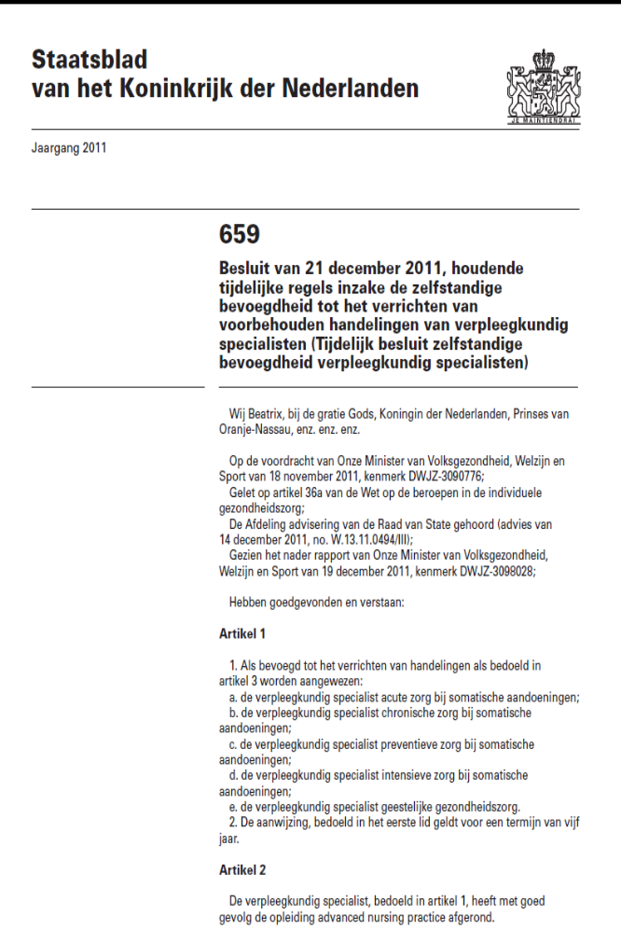
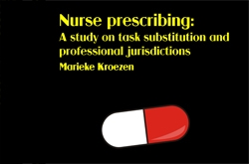
Milestone
From 2012: legal right to prescribe medication
Notes:
A recent study shows that a recipe of an advanced nurse practitioner is safe. They prescribe the correct pills and dosages, in the same way as doctors do. August 2014
Het ministerie van Volksgezondheid, Welzijn en Sport (VWS) probeert al langer taken van artsen over te dragen aan goedkoper en lager opgeleid personeel. Sinds 1 januari 2012 is er in de Wet BIG een experimenteerartikel opgenomen dat twee beroepsgroepen extra bevoegdheden geeft, zoals het voorschrijven van medicijnen en het stellen van diagnoses. Het gaat hierbij om de Verpleegkundig Specialist, een verpleegkundige met een tweejarige aanvullende opleiding, en de Physician Assistant, iemand met een hbo-opleiding in de gezondheidszorg en een vervolgopleiding van 2,5 jaar. Dit experiment duurt vijf jaar. Na deze periode wordt besloten of de afspraken uit het experimenteerartikel definitief in de wet worden vastgelegd
Door het in werking stellen van het experimenteer artikel 36a met de daarbij behorende AMvB op 1 januari 2012 kan de verpleegkundig specialist een zelfstandige behandelrelatie aangaan met een patiënt en heeft deze een aantal extra bevoegdheden. Zij mag zelf diagnosticeren, behandelen, medicatie voorschrijven en een aantal voorbehouden handelingen zelfstandig indiceren en uitvoeren.
Het betreft handelingen:
die moeten plaatsvinden binnen de uitoefening van het deelgebied van het beroep waarvoor zij een erkende specialistentitel mogen voeren;
van een beperkte complexiteit;
van routinematige aard;
waarvan de risico’s te overzien zijn;
die worden uitgeoefend volgens landelijke geldende richtlijnen, standaarden en daarvan afgeleide protocollen; en
afhankelijk van het specialisme:
het verrichten van heelkundige handelingen;
het verrichten van catheterisaties;
het geven van injecties;
het verrichten van puncties;
het toepassen van defibrillatie;
het verrichten van elective cardioversies;
het verrichten van endoscopieën;
het voorschrijven van geneesmiddelen die uitsluitend op recept verkrijgbaar zijn

Slide 21
Any Questions?

